Slide 1
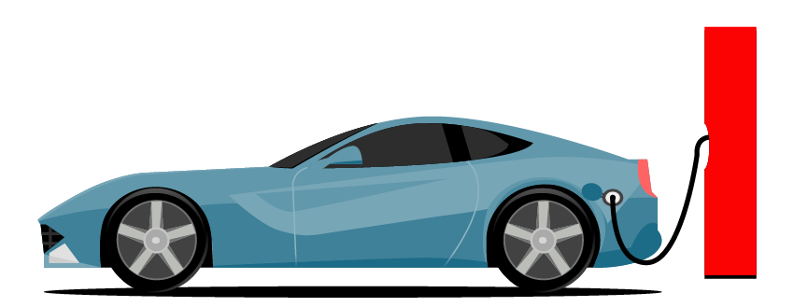
Basic Details of the Team and Problem Statement
TEAM NAME: TECH_BOSS
IDEA TITLE: ELECTRIC VECHICLE CHARGING SYSTEM
TEAM LEADER NAME: DEVADHARSHINI U
DOMAIN NAME: SMART CITY
PROBLEM STATEMENT: LACK OF ADEQUATE CHARGING STATIONS AND NO MEANS OF COMMUNICATION WITH VEHICLE DRIVERS , ABOUT THE CURRENT CAPACITY OF CHARGING STATIONS.

Slide 2
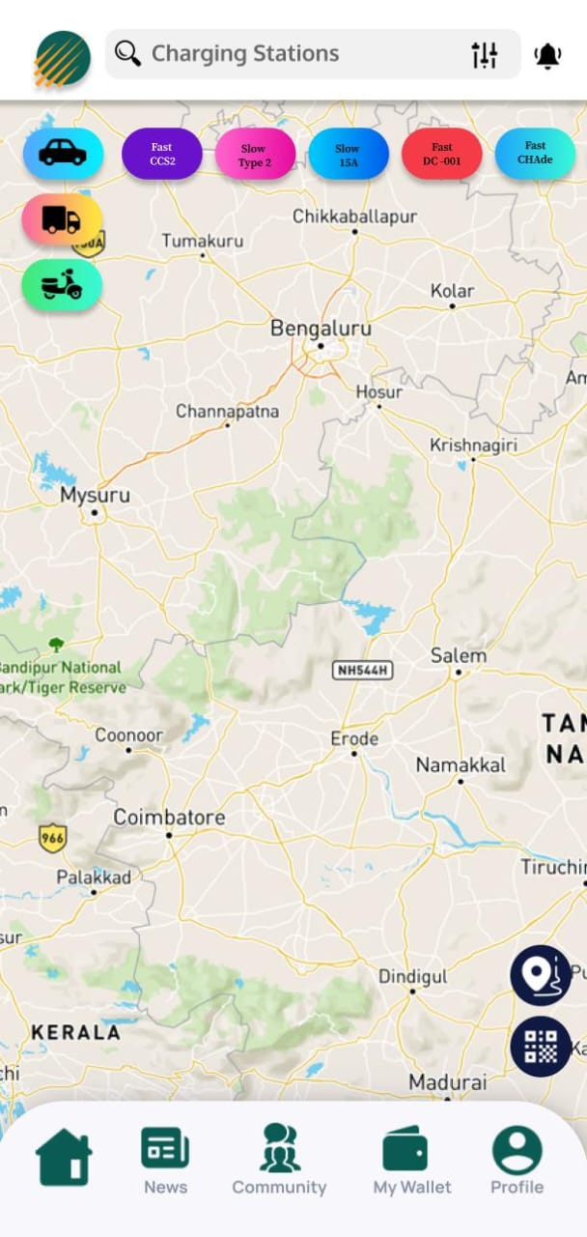
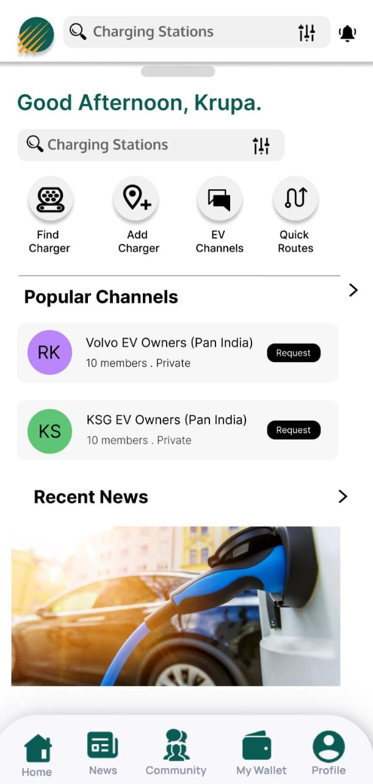
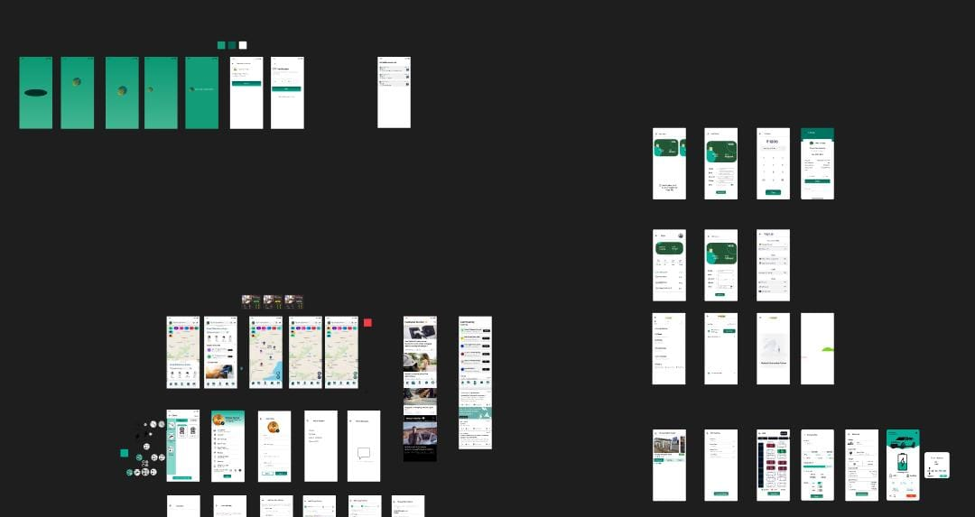
Idea/Approach Details
In recent years, urban areas have faced increasing challenges related to traffic congestion, air pollution, and carbon emissions.
Electric vehicles (EVs) present a promising solution to address these issues while promoting sustainable transportation.
Creating an user-friendly EV charging network booths that maximizes the renewable energy consumption in road transportation which in turn helps to achieve net zero.
Robust charging infrastructure for EV cars, buses, 2-wheelers & 3-wheelers.
These stations are certainly the future. Real time availability of charging stations & capacity open source.
Slot booking & waiting options available at inbuilt lounges. AI integrated location & capacity tracker Integration of alternatives like solar panels during uncertainty.
Describe your Technology stack here:
FRONT END : FLUTTER AND DART
BACK END : GCP (NODE JS –CONNECTIVITY)
WEB SOCKET CREATION IN API CALL(OCPP)
EV MANAGEMENT

Slide 3
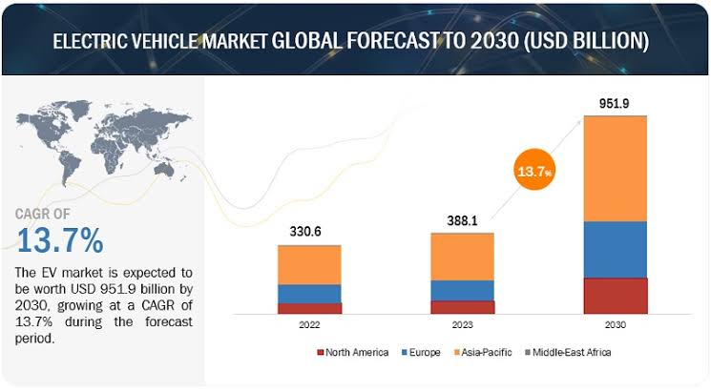
Idea/Approach Details
Describe your Use Cases here
Describe your Dependencies / Show stopper here
Environmental Impact: EVs produce zero tailpipe emissions, reducing air pollution and mitigating climate change.
Cost Savings: Lower operating costs due to reduced fuel and maintenance expenses compared to traditional vehicles.
Energy Efficiency: EVs are more efficient in converting energy from the grid to power the vehicle compared to internal combustion engine vehicles.
Improved Public Health: Reduced emissions lead to cleaner air, resulting in fewer respiratory illnesses and improved public health.
Noise Reduction: Electric motors operate quietly, contributing to quieter and more peaceful urban environments.
The successful adoption and implementation of electric vehicles (EVs) depend on several key factors and dependencies:
Charging Infrastructure
Battery Technology
Government Policies and Incentives
Consumer Awareness and Education
Vehicle Affordability and Availability
Range and Charging Speeds Collaboration among stakeholders, including automakers, Environmental and Energy Policies

Slide 4

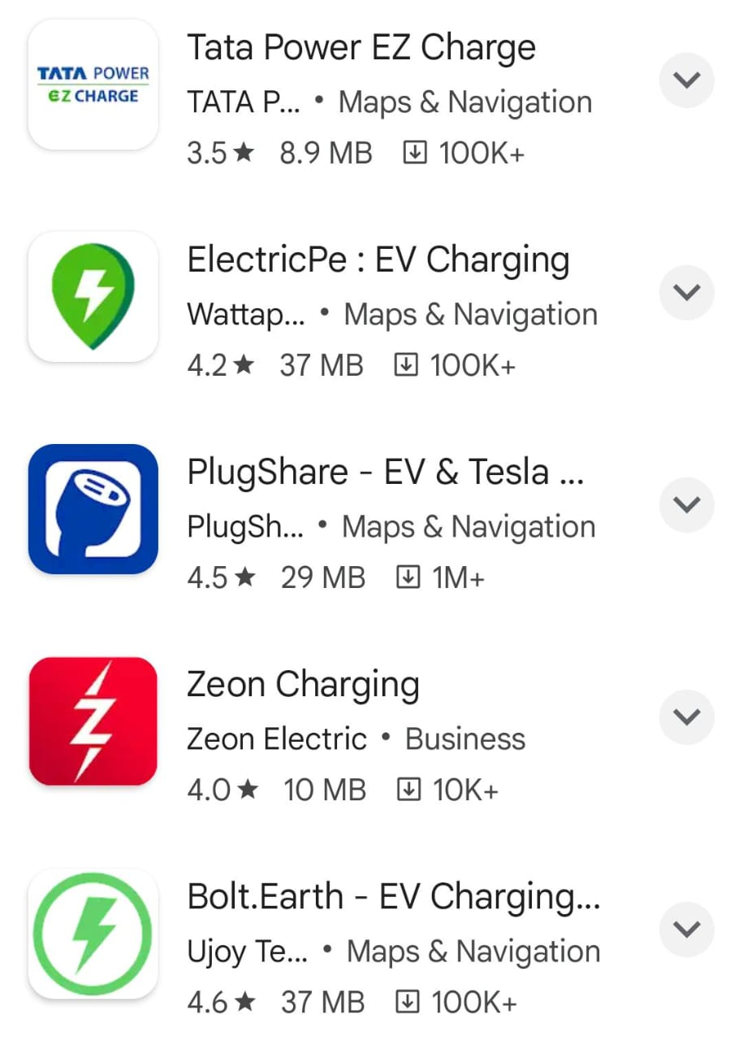
CHARGE PARTNER
OTHER EV APPS
OUR CREATION EV APPS
It will be easy and convenient steps to process it in a low price(TOP UP)
App ensures us to get the best experience from plugin to full charge
We can easily
View live charging status
Charge types to map compatibility with your EV
Filter by type of connectors
Help to find our own reviews and ratings
Simple scan action
1.Charge %
2.Time Left-out
Historical transaction is provided ,it says about the money sent at which charging station and when
Reminders for keeping sufficient balance in account

Slide 5
CHARGE PARTNER
WORK FLOW
EV vehicles(connector type) -------> EV Machine
| |
Charging server Embedded System
| |
OCPP(it gives) RFID
| GPS
Car battery status(%) ELECTRIC METER
| IN-BUILD MONITOR
Full charge(90%-3hrs) OCPP INTEGRATED OS
| |
Connection (API-call) Charging connector(Type)-------> Cloud Server
| |
Format WEBSOCKET Reserve charge
| |
Token generate Payment Gateway
| |
Display Result Token App
CHARGE%
TIME LIFEOUT

Slide 6
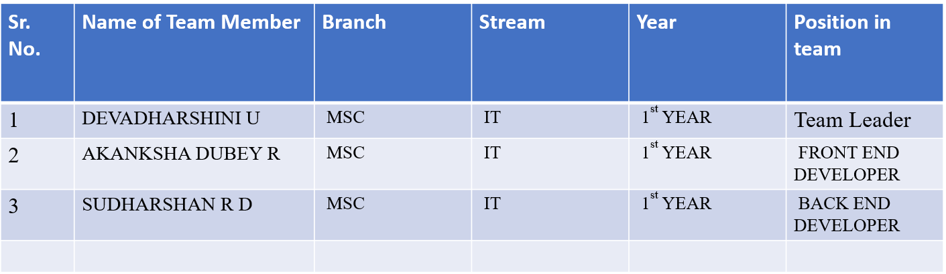
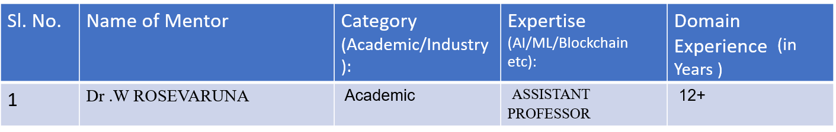
Team Member Details
Team Mentor/s Details

